Slide 1
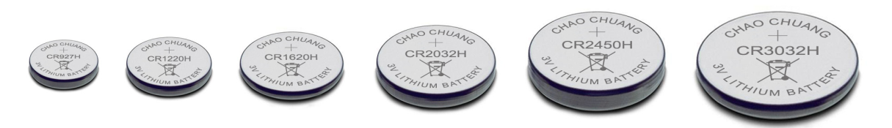
CR Battery Presentation
SHANGHAI BIZUPWINGS I&E FOREIGN TRADE CO.LTD.

Slide 2
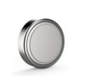
Product Lineup
More than 30 models and 4 grades. Most fully CR Coin maker in China.
Series | Number of product lines | Capacity (Million/M) | Model
CR2032 | 21 | 50 | CR2032
CR2025 | 6 | 12 | CR2025
CR2016 | 9 | 9 | CR2016
CR24XX | 4 | 7.5 | CR2450、CR2477、CR2430 CR2320、CR2325、CR2330、CR2354 CR3032
CR16XX | 3 | 3.5 | CR1616、CR1620、CR1625、CR1632
CR12XX | 4 | 4 | CR1216、CR1220、CR1225
CR9XX | 1 | 1 | CR927、CR1025、CR1130
Total | 48 | 87 | 30 Models
Product category
SH: Super High Capacity with
Nickle Plating
H: High Capacity with Nickle
plating
N: Normal Capacity
WT: Wide Temperature Range

Slide 3
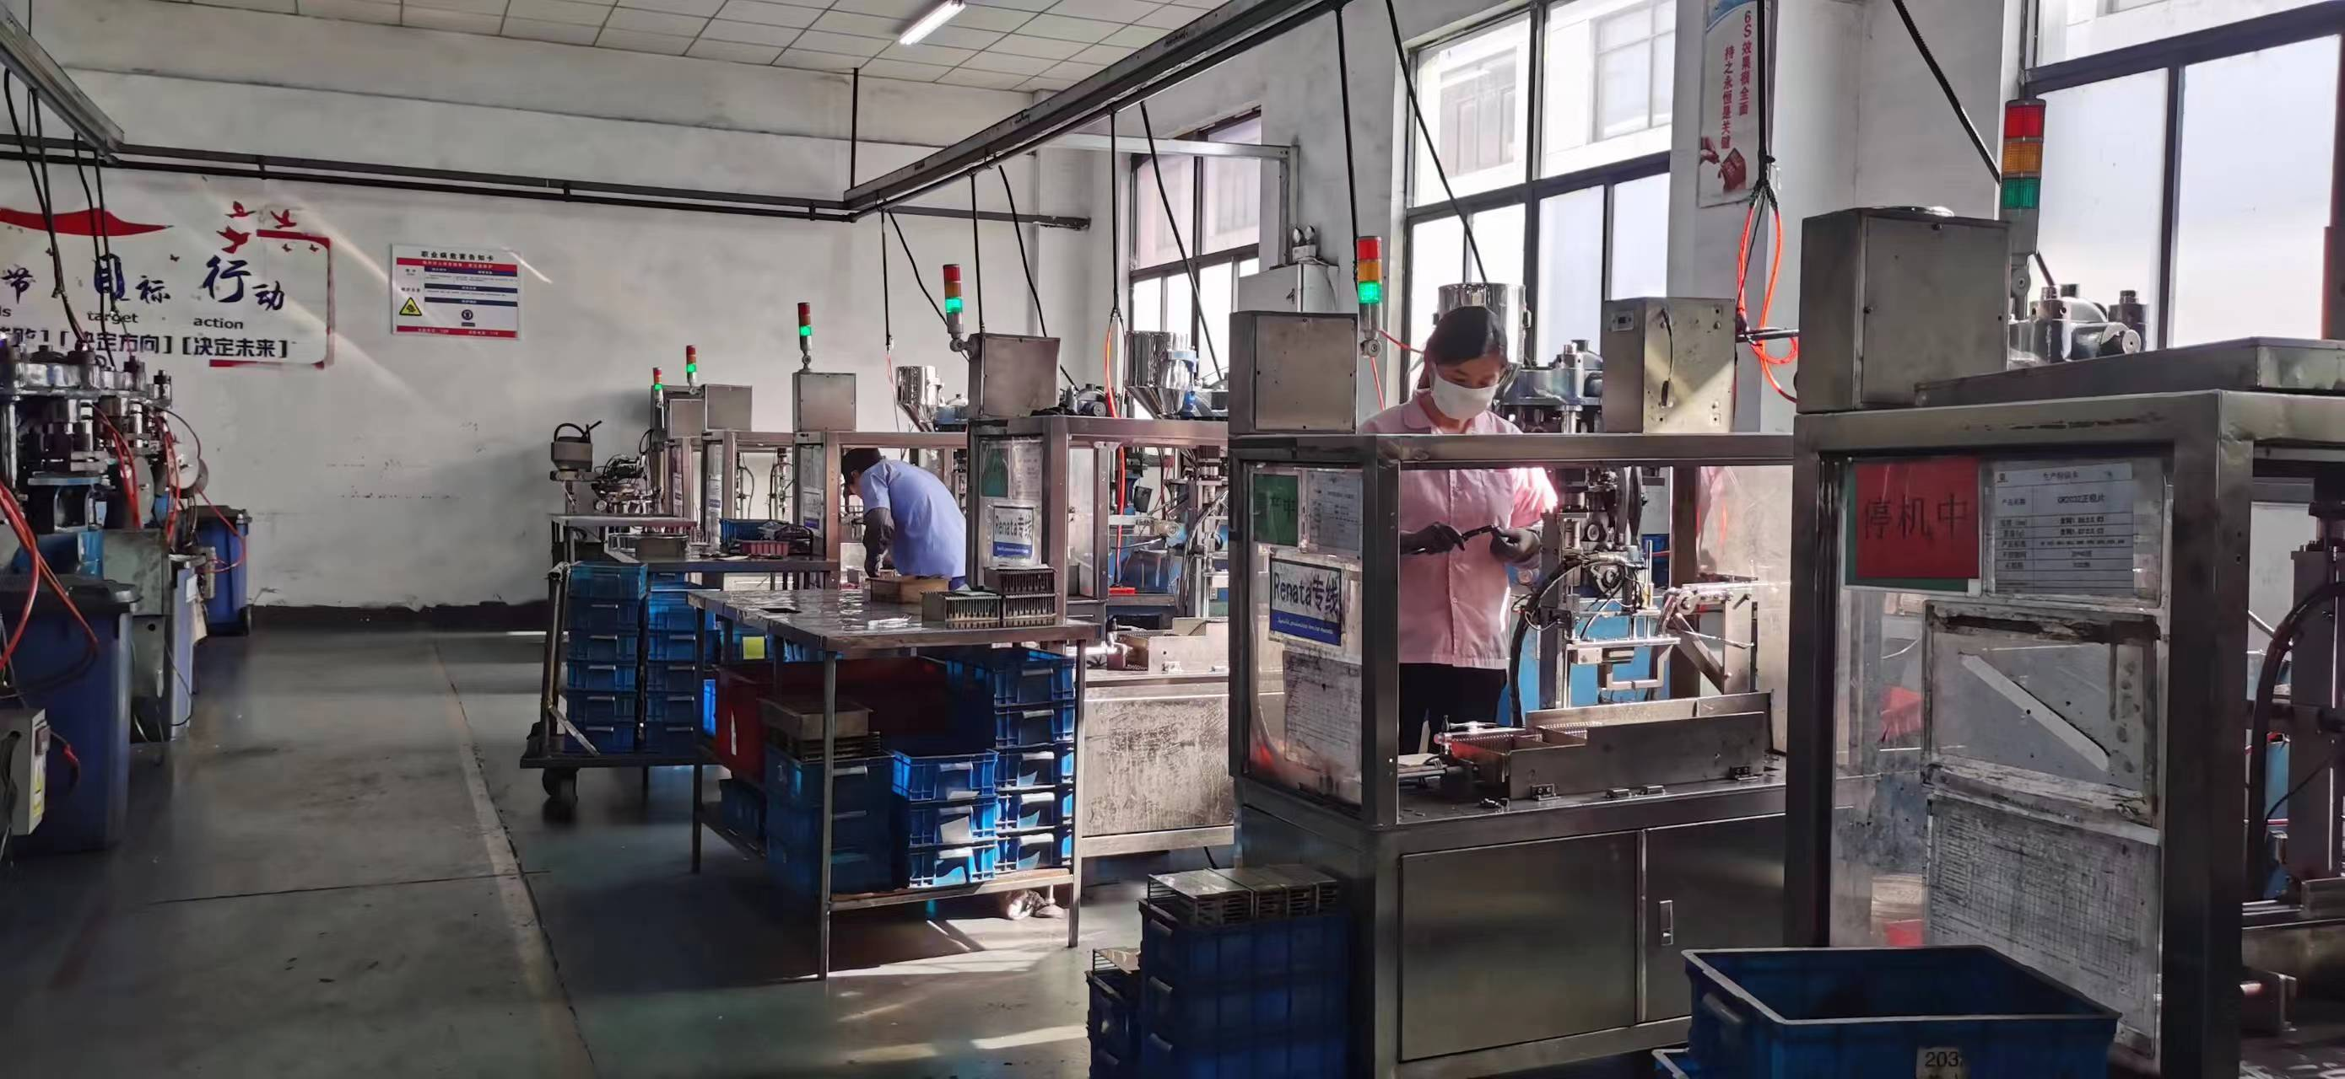
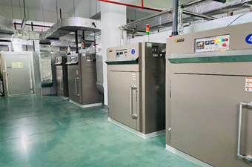
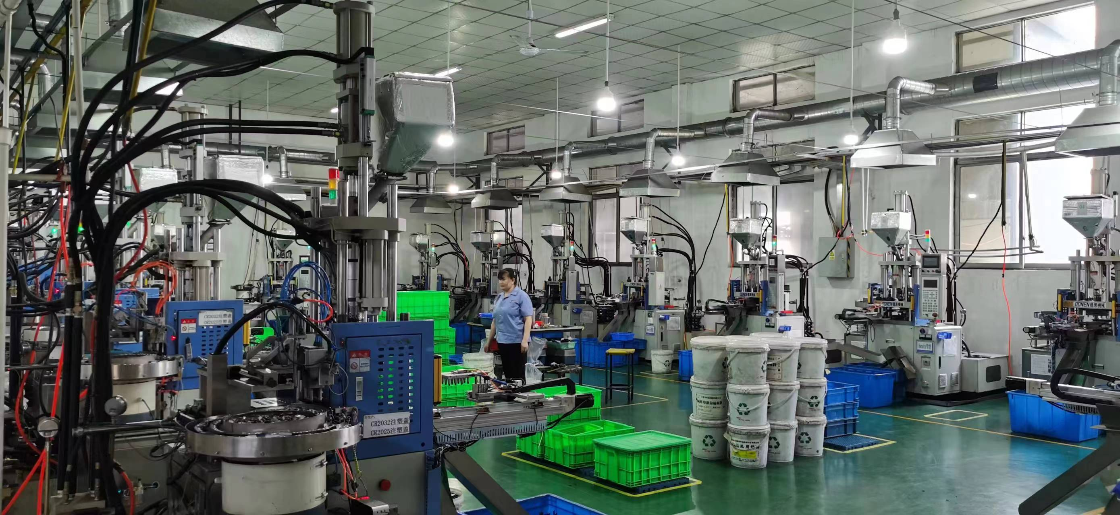
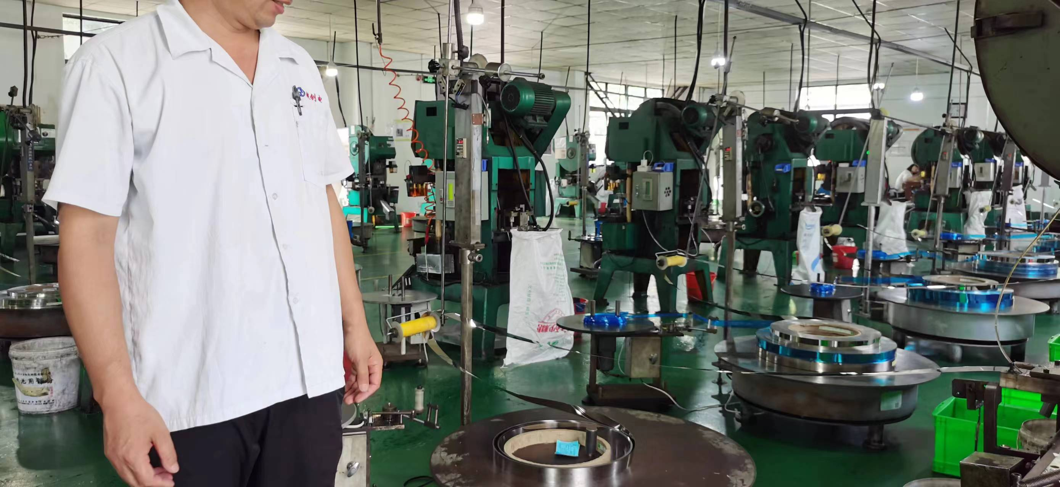
Parts
Positive MnO2 Pressing
Positive MnO2 Dry
Gasket Injection
Positive Plate Pressing

Slide 4
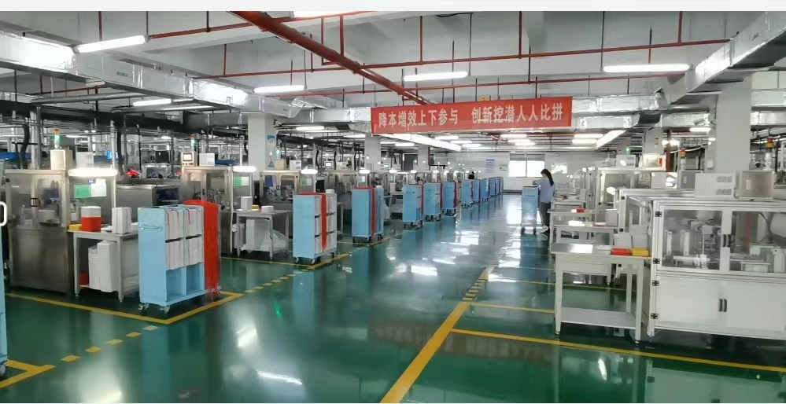
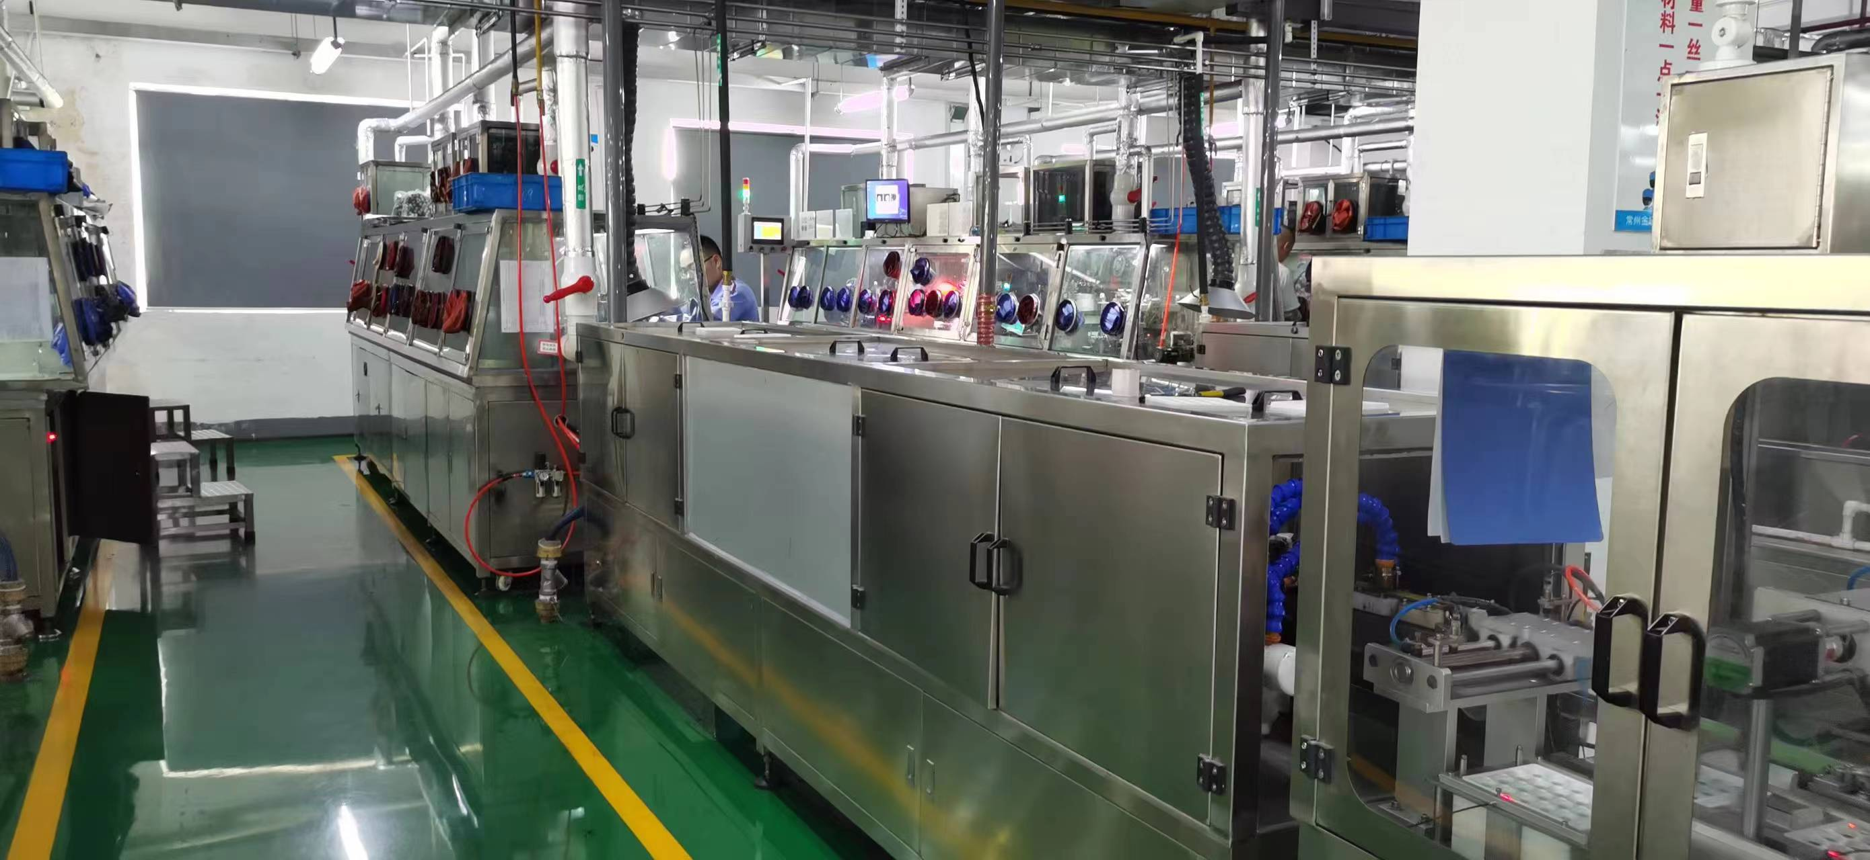
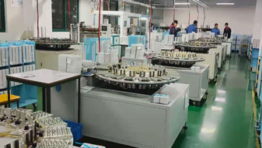
Assembly
1 Cut Lithium Sheet
2 Making Lithium Parts
3 Cut Separator
4 Put Positive Into Cell
5 Close The Anode
6 Automatic Cleaning
7 Automatic Plating
8 Physical Discharge

Slide 5
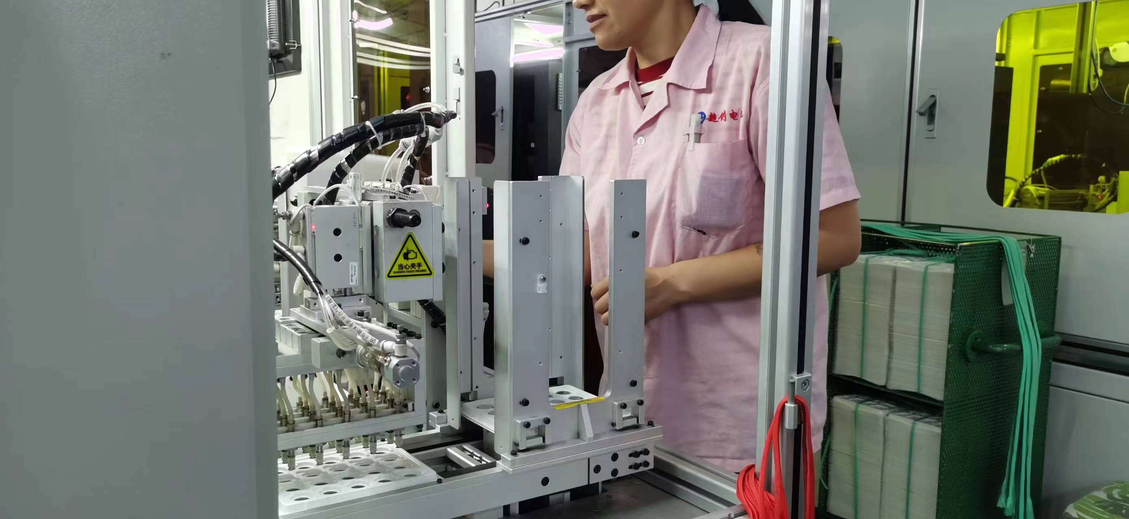
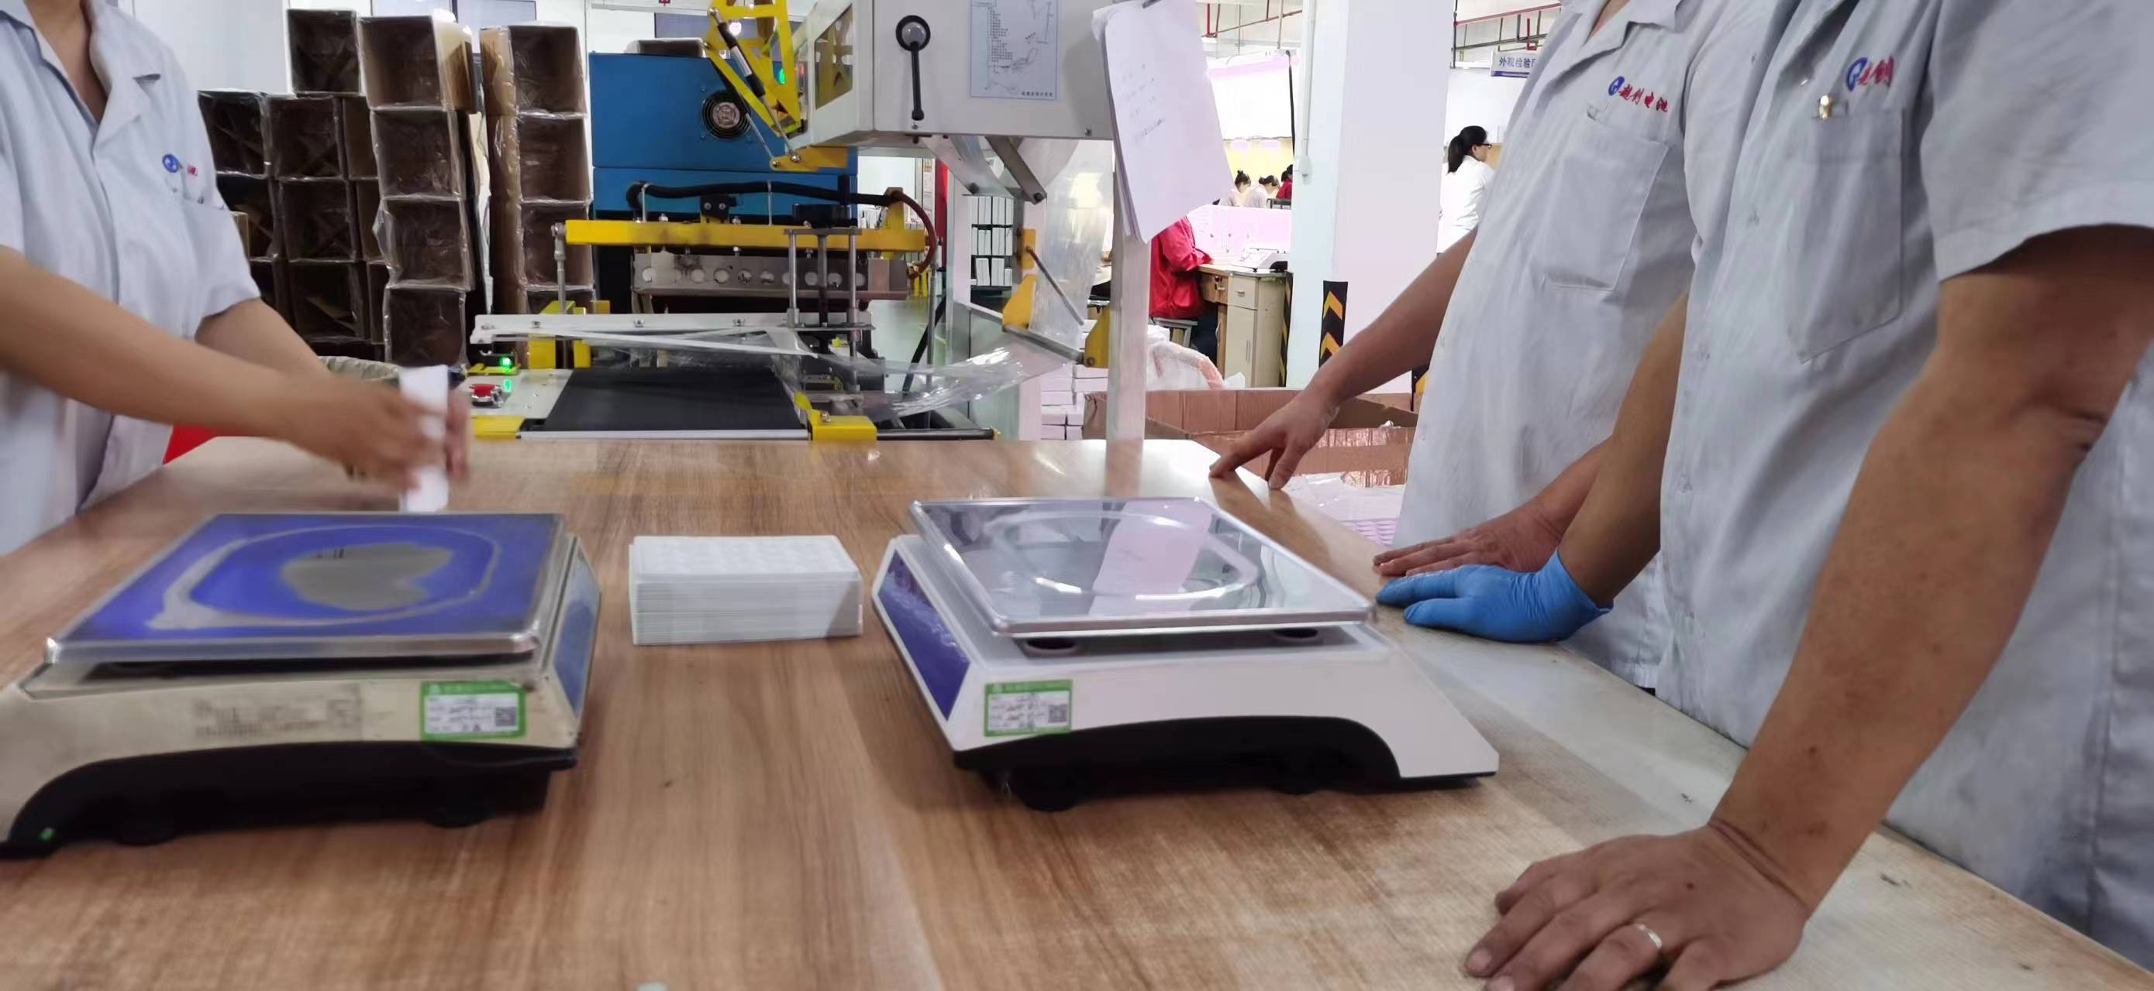
Appearance inspection & packaging
Automatic Visual Inspection Machine
Packaging Equipment

Slide 6
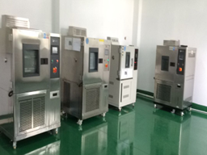
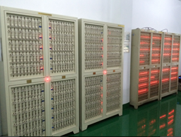
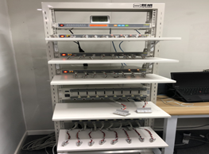
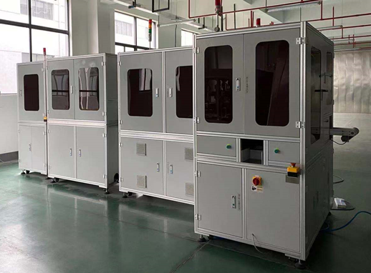
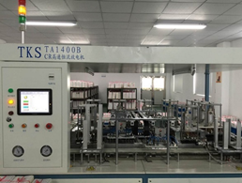
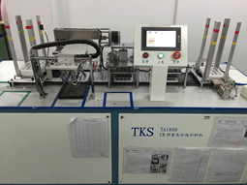
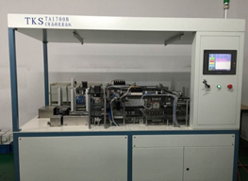
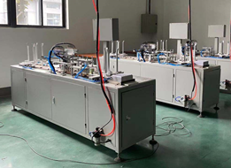
Test Equipment
Temperature & Humidity
Chamber
Discharge Test Machine
1800 channels
Pulse Discharge
Apparatus
Automatic Visual
Inspection Machine
High Accuracy Constant Pre-discharge Auto machine
High Accuracy Function Test Auto-machine
High Accuracy Height Checking Machine
Automatic Electrical Performance Testing Machine

Slide 7








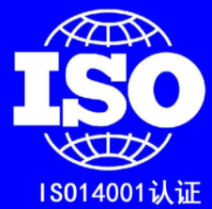

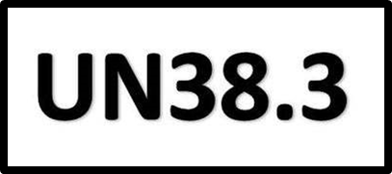


Certification
by

Slide 8
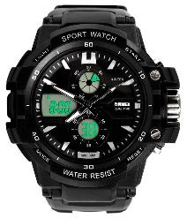
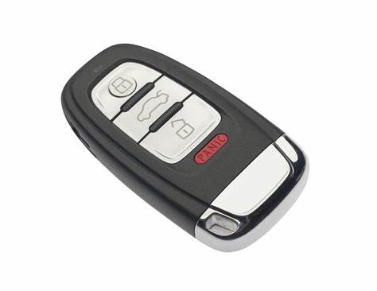
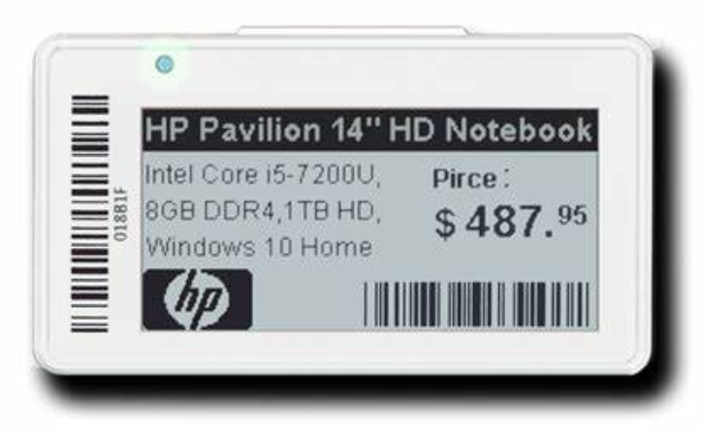
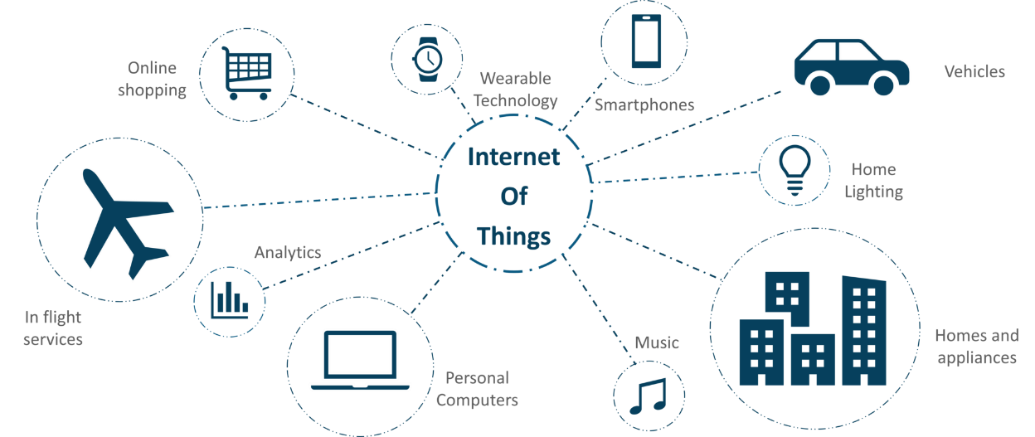
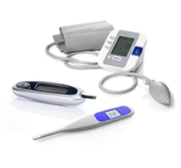
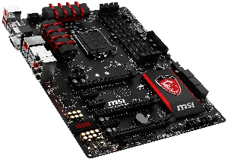
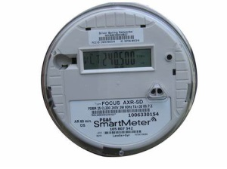
Applications
Remote Controllers
Smart Home Appliances, IOT Devices (Backup, Communication, Low Energy Bluetooth)
Notebook, Desktop Motherboard
Medical Instruments, Inhaler, Insulin Injector
Keyless Entry Systems
TPMS, EV Station Meter
Watches (GPS, Sports)
Price Tags, Communication Tags, Electric Tokens
Calculators, Electronic Dictionaries
Electronic Meters (Water, Gas, Electricity)
FA Instruments (Measuring Instruments, Onboard Microcomputers, Sensors)

